Slide 1
Course introduction
PE&RC theoretical ecology course 2025
Jasper Croll & Hanna ten Brink

Slide 2
Lecture goals
Introduce some basic concepts
Discuss the course outline

Slide 3

Two questions to get started
What do you associate with theoretical ecology?
What is your association with models?
https://www.menti.com/
Code: 6570 4787

Slide 4
Aim of theoretical ecology
The aim of theoretical ecology is to describe, explain and predict ecological patterns and dynamics through fundamental principles and mechanisms

Slide 5

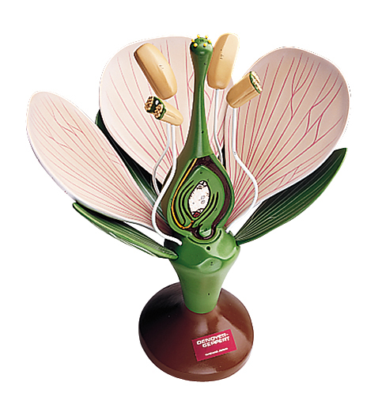

Models
Models are an abstraction or simplification of reality
Mental model
Physical model
Mathematical model
Statistical model
lm(y~x)
Mechanistic / Dynamic model

Slide 6
Dynamic models
Equations to describe changes over time
Process description:
Deterministic: Every time the results are the same for every calculation
Stochastic: Random values make results unique for every calculation
Time description:
Continuous
Discrete
Time
0
1
2
3
4
5
6

Slide 7
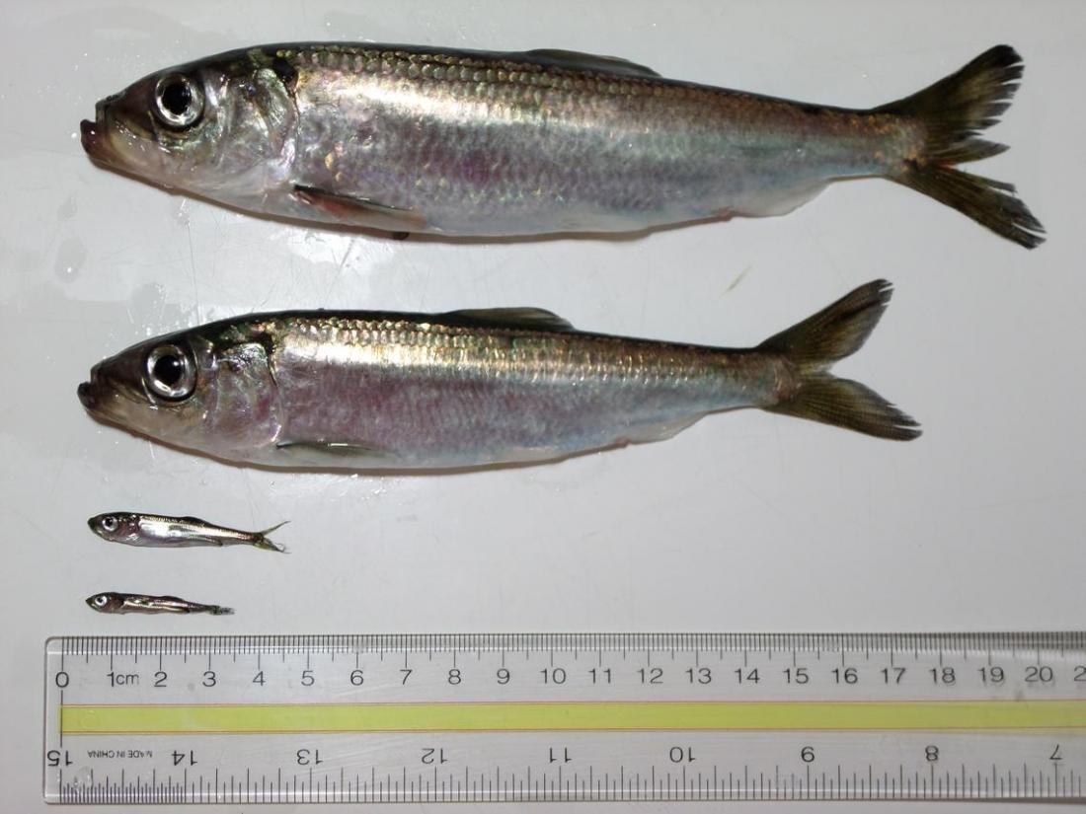


Model complexity
Number /
Density /
concentration
Spatial context
Population structure
Evolution

Slide 8
Course schedule
 | Monday | Tuesday | Wednesday | Thursday | Friday
Morning | L1: Introduction | Computer lab 1 | L4: Bifurcations | Guest lecture: Structured populations | Guest lecture: Adaptive dynamics
 | L2: ODE models |  | Computer Lab 3
 |  | L3: ODE models
Afternoon | L2: ODE models | Computer lab 2 | Facultative activities Walk Math hour practice | Computer lab 3
 | Computer lab 1
 | Computer lab 1 |  |  | Discussion + posters
Evening | Discussion on theoretical ecology | Guest lecture: Spatial models |  | Course feedback

Slide 9
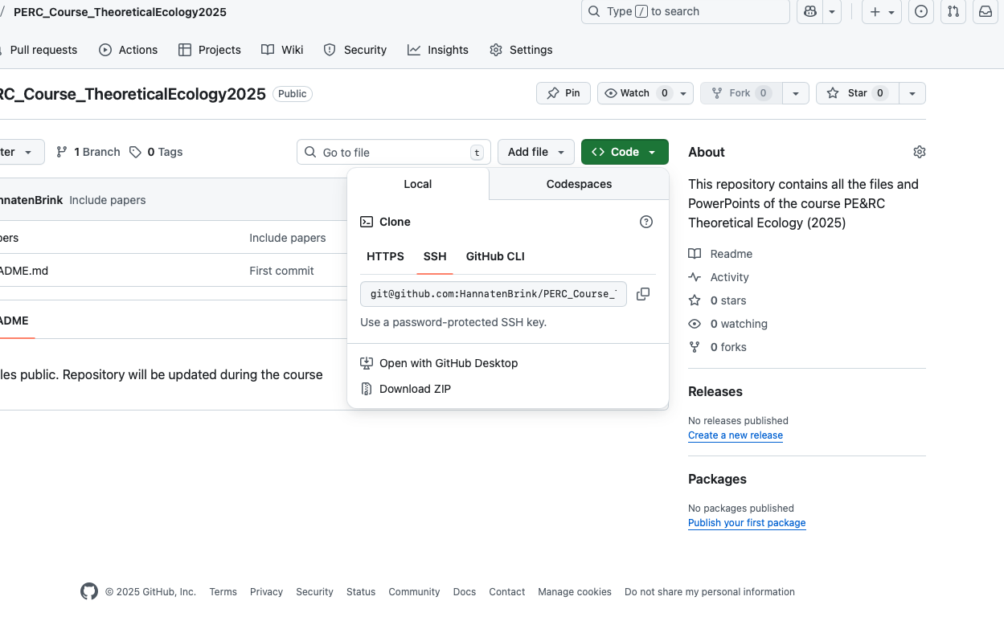
Course information: Github repository
All files (powerpoints, computer practica) will be made available via Github
https://github.com/HannatenBrink/PERC_Course_TheoreticalEcology2025
If you are not familiar with github, press the green ‘Code’ button
-> Download ZIP

Slide 10






ODE models
One equation for every population
Change over time
$\frac{Change in number}{change in time}=\frac{∆N}{∆t}$
$$→\frac{dN}{dt}$$
$$∆N$$
$$∆N$$
$$∆t$$
$$∆t$$

Slide 11

ODE models: Equation
$\frac{dN}{dt}=in −out$
$\frac{dN}{dt}=birth −death (±migration)$
$\frac{dN}{dt}=b N −d N$
Variable: changes over time
Parameters: constant value
term

Slide 12
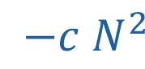
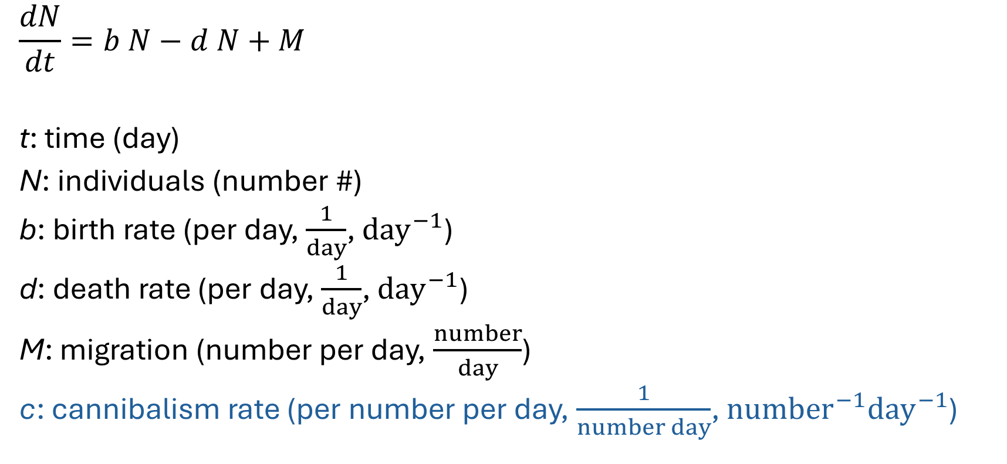
ODE model: units
Practice:
Add cannibalism to the equation
Determine the units of the new parameters
$$\frac{dN}{dt}=b N−d N+M$$
t: time (day)
N: individuals (number #)
b: birth rate (per day, $\frac{1}{day}$, ${day}^{−1}$)
d: death rate (per day, $\frac{1}{day}$, ${day}^{−1}$)
M: migration (number per day, $\frac{number}{day}$)
c: cannibalism rate (per number per day, $\frac{1}{number day}$, ${number}^{−1}{day}^{−1}$)
$$−c N^{2}$$

Slide 13

ODE model: units
Practice:
Determine the units
$$\frac{dN}{dt}=b N−d N+M−c N^{2}$$
t: time (year)
N: individuals ($\frac{number}{m^{2}}$)
b: birth rate ($\frac{1}{year}$)
d: death rate ($\frac{1}{year}$)
M: migration ($\frac{number}{m^{2} year}$)
c: cannibalism rate ($\frac{m^{2}}{number year}$)

